Slide 1

vSURF
Cem practice
Virtusa Blueprint for Microservices
Srinivas Gopinath Parimi (srinivasgopinathp@virtusa.com)
13-February-2018

Slide 2



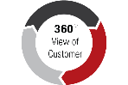







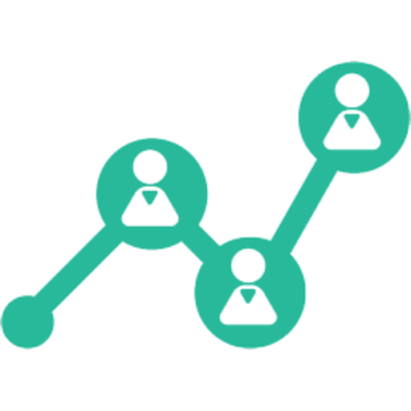






vSURF – Virtusa Blueprint for Microservices
vsurf
Scalable. Upgradeable. Robust. Fast.
Research
Buy
Engage
Advocate
UI:
React + Redux /
Angular / Android / iOS
Personalized omnichannel experiences
24
Mobile
Social
Call center
Self Service
Retail Outlet
Online
Touchpoint Transformation across all channels
CMS:
AEM / Alfresco / Oracle / Sitecore / Office 365 / Liferay
Content
Management
Product
Catalogue
Promotions
& Offers
Customer 360
Document Management
Next Best Actions
Campaign Management
Loyalty Management
Offline
Communication
Forms
Experience Orchestration driven by Business
Microservices:
Spring Cloud / WildFly / Mulesoft / OSGi / .NET / NodeJS
£
Single
Sign On
Address
Validation
Digital Wallet
& Payments
Business
Rules
Statutory
Validations
Sales Executive Appointments
Reporting & Analysis
3rd party
Services
Alerts & Reminders
Microservices
Other Services
Messaging:
Kafka / Amazon SQS
Fully Integrated Digital Platform powered by Microservices
Data Lake:
MongoDB / CouchDB / Hbase + Hadoop
Single Source
of Truth
Billing
Ordering
CRM
Other Data
Streamlined Back-office operations with Single Source of Truth

Slide 3
vSURF
vsurf
Virtusa Accelerator for Microservices
Omni-channel Product Application Framework
Improve user engagement across all channels. Integrate easily with state-of-the-art analytics, AI / Machine Learning, IoT applictions
Manage, Monitor, Monetize
Mobile Apps Foundation Framework
Rapidly create mobile apps and deliver an engaging experience. Push content and notifications with no development.
Faster is Better
vSURF offers ready-to-use components that enable our clients to bring experiences to their audiences faster
Rapidly create mobile apps and deliver an engaging experience. Push content and notifications with minimal development.
Authenticated sites
Improved Brand Equity
Build authenticated user portals and presents them with personalized experience, user data, and targeted offers
Plug and Play components have been designed keeping in mind the important parameters of digital branding, multi-channel conversations and personalization
Accessibility and SEO
Compliant with accessibility guidelines under section 508, WCAG, and SEO standards

Slide 4
Some of the components offered by vSURF
vSURF COMPONENT LIBRARY
1 | Account Summary
2 | Add to Cart
3 | Advanced Search
4 | Alert
5 | Appointment
6 | Area Chart
7 | Article
8 | Assisted Forms
9 | Audio
10 | Banner
11 | Bar Chart
12 | Basic Grid
13 | Blog
14 | Branch Locator
15 | Breadcrumb
16 | Buttons
17 | Calendar
18 | Call To Action
19 | Cards
20 | Carousel
21 | Columns
22 | Column Graph
23 | Compare Products
24 | Coupons
25 | Data Exporters
26 | Document Download
27 | Donut Chart
28 | Download Statement
29 | Drafts
30 | Drag & Drop
31 | Draw
32 | Edit Profile
33 | Editable Grid
34 | Email Template
35 | E-Signature
36 | FAQ
37 | File Uploader
38 | Footer
39 | Forms
40 | FX
41 | Hamburger Menu
42 | Header
43 | Hero
44 | Interest Calculator
45 | KYC Upload
46 | Layouts
47 | Line Chart
48 | Link
49 | List
50 | List of Links
51 | Login
52 | Loyalty Rewards
53 | Main Menu
54 | Menu
55 | Newsletter Page
56 | Order Cancellation
57 | Order Confirmation Email
58 | Order Confirmation SMS
59 | Order Details
60 | Order History
61 | Order Tracking
62 | Paginated Grid
63 | Panels
64 | Payment Method
65 | Pie Chart
66 | Popup
67 | Pre-book
68 | Product Catalog
69 | Product Detail
70 | Product Mix
71 | Product Reservation
72 | Product Review
73 | Progress Indicator
74 | Progressive Grid
75 | Promotion
76 | Query
77 | Rating
78 | Recommendations
79 | Reconfigurable Grid
80 | Refund
81 | Reminder
82 | Review
83 | Ripple
84 | Scribble Signature
85 | Search Box
86 | Search Filters
87 | Search Results
88 | Sheet
89 | Shopping Cart
90 | Social Media Sharing
91 | Spot
92 | Stock Ticker
93 | Synchronized Grid
94 | Table with Filters
95 | Tabs
96 | Teaser
97 | Thank You Message
98 | Title
99 | Title Bar
100 | Toolbar
101 | Tooltip
102 | Top Navigation
103 | User Dashboard
104 | User Preferences
105 | Video
106 | Virtual Agent ChatBot
107 | Voting
108 | Voucher
109 | Welcome Kit
110 | Wizard

Slide 5
Success story: Lloyds Bank

Slide 6




Legato – Conceptual Architecture
Lloyds Bank
Who
Markets Sales team members are the end users.
What
Blotter and Data Console are the major parts.
Blotter operates on streaming data
Data Console operates on stored data
Why
Goal is to equip Sales people with tools for:
Maximizing the profitability of trading transactions for the customers
Protecting the customer investments from domino effects of trading markets
MIFID-II regulatory compliance
RFQ, Trading Activities,
Ref-Data, Credit Ratings, etc.
Markets Sales Team
Blotter
Data Console
Streaming Data
Data Lake

Slide 7





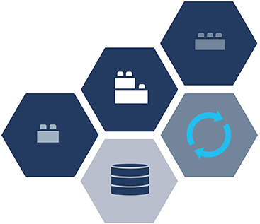



Legato – Logical Architecture
Lloyds Bank
Sales Users
Load Balancer
ZUUL
ZUUL
SPRING CLOUD
EUREKA
EUREKA
Microservices
Microservices
DATA LAKE
Legacy Data

Slide 8
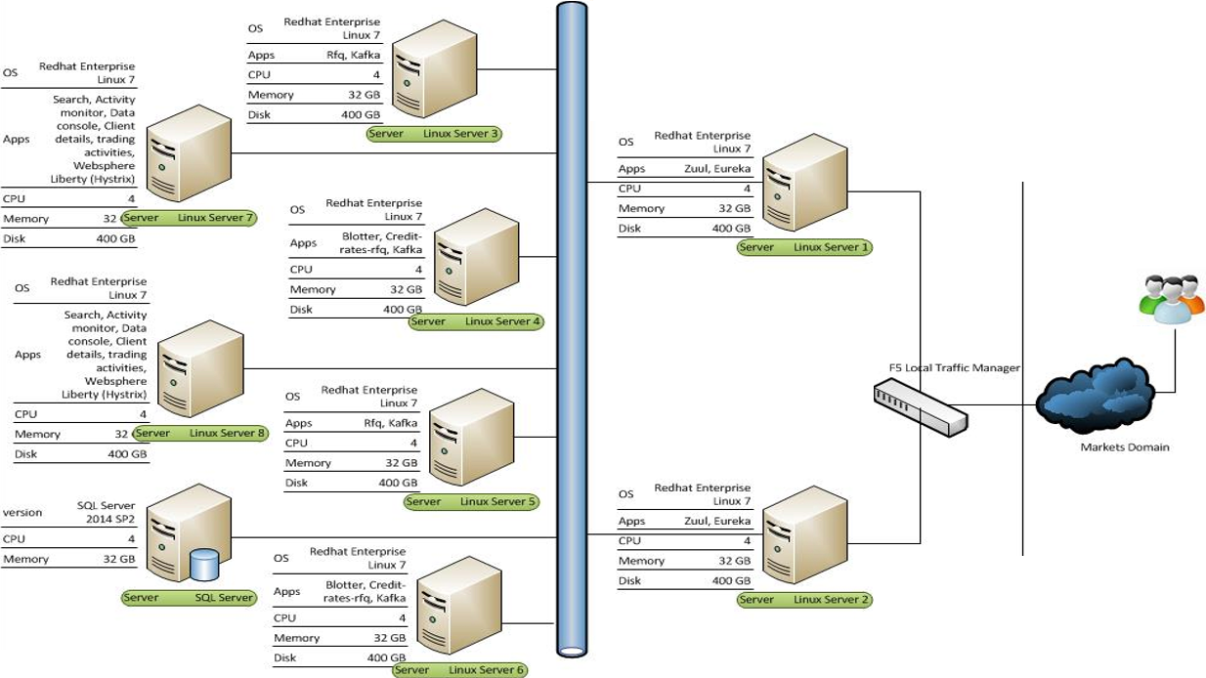
Legato – Physical Architecture
Lloyds Bank

Slide 9
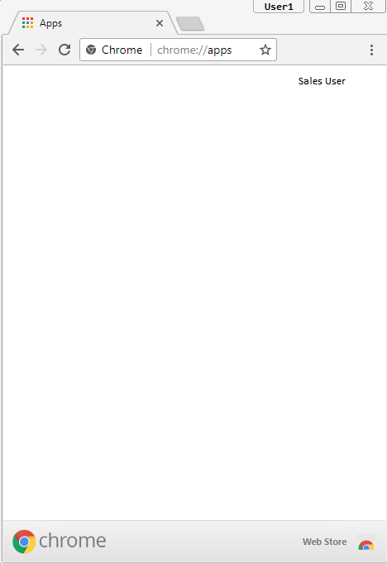










UI with Chrome App Store
Lloyds Bank
React & Redux UI Apps served through Chrome App Store offer
Centralized Management
High Performance
Streamlined Updates
Push Notifications
Personalization
Legato Blotter
Stock Analysis
Smart Trade
FX+
Data Console
Know Your Money
RFQ
IFX
Market Watch

Slide 10



Legato – Solution overview
Smart trading solution for profitability and protection from the domino effects of markets
Solution Development
Virtusa develops a robust trading solution for Lloyds bank that offers the industry best investor protection, profitability and MIFID-II compliance.
Features
Selection of the best trading venue for the execution of orders for the specified covering price, volume and repetition.
Simulation of High-Frequency Trading (HFT) Algorithms over aggregated pre-trade and post-trade data and thereby reducing the propensity for errant algorithms to propagate shocks through the financial system.
Real-time recording and disclosure of Pre-trade and post-trade activities involving exemptions from the general obligation to display prices and sizes for orders that are large in scale, orders executed via negotiated transactions, orders executed on reference price systems and iceberg orders (orders executed via an order management facility).
Implementation of the “double volume cap” regulatory mechanism to limit dark pool trading. Under this mechanism, trading volume in a given stock on any venue operating under a pre-trade transparency waiver (e.g., a dark pool) cannot exceed 4% of total volume on organized trading venues, and total trading under these waivers (across all venues) for a given stock cannot exceed 8%.
Technology Microservices architecture* with Kafka, Spring Boot, Netflix OSS, React-Redux (Reference: vSURF)
Team 4 offsite + 9 onsite
Key Accomplishments
Successful delivery of 900+ user stories. On-time completion of 8 sprints.
20% reduction in defects / sprint
MTTR for defects < 1 day
Innovation & Value-add by Virtusa
Intelligent Log Analytics solution to drive elastic scaling, rapid recovery and security incident responses.
vSURF is Virtusa’s blueprint for Microservices, which incorporates the best-practices in building the 4 core principles of Microservices – Security, Upgradeability, Resilience, Fast processing.
Offshore team operates as an extension of the onsite team, with Streamlined operations for development, testing, deployment and application support

Slide 11
Success story: Nanyang Technological University

Slide 12

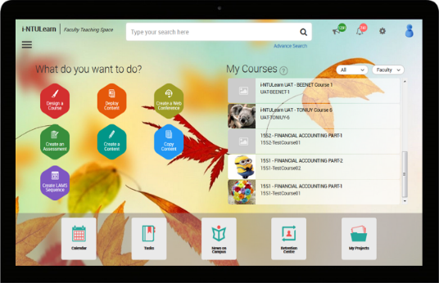
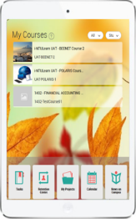












Solution Architecture
Ntu singapore
Presentation
Layer
Web Services
Search Gateway
Aggregation
Layer
Navigation Flows
Data Indexing
Business Rules
HPE Idol
Machine Learning
MuleSoft ESB
McGrawHill
NBC
Lynda
Turn It In
Content
Management
Layer
Blackboard
LAMS
eUreka
AcuLearn
Cengage
Ithenticate
Enterprise
Services
Layer
NetIQ
Active Directory
SQL Server
SIS Database
MongoDB
Other Systems

Slide 13

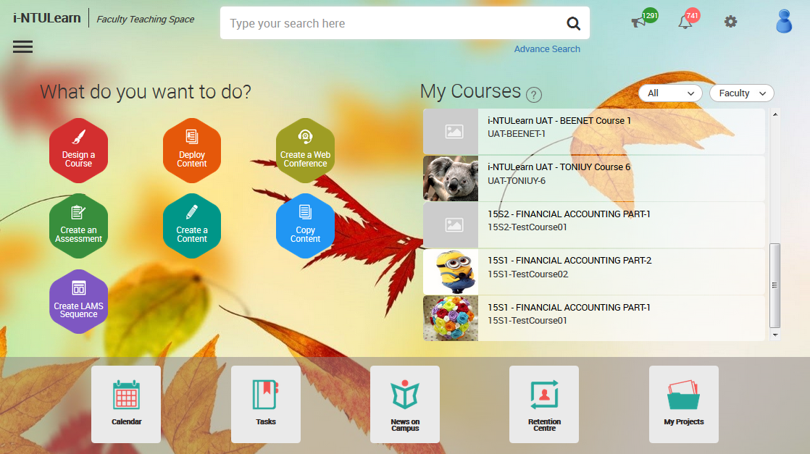

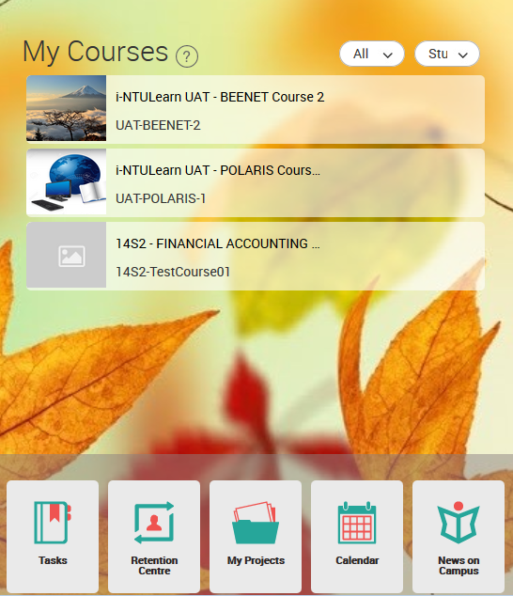

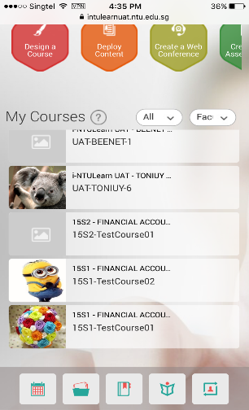
Adaptive User Experience
NTU Singapore

Slide 14












An eco-system of enhanced learning and agile teaching experiences for one of the best Universities
Case study – UNIVERSITY EDUCATION - NTU Singapore
Solution Architecture
World’s # 1 Young University and one of the overall Top 15 in the world.
High number of Staff, Students, Departments, Courses, Global partnerships, Industry alliances and Affiliated institutions
Buzzing with year-round events on Research and inventions
Client
Presentation
Layer
Complicated and inflexible means of creating content and administering courses
Inconsistent user experiences due to ad-hoc systems scattered across the landscape
Ineffective means of providing relevant information to the right user at the right time.
Insufficient insights into student segments and performance of courses
Web Services
Search Gateway
Business Problem
Navigation Flows
Data Indexing
Aggregation
Layer
MuleSoft ESB
Business Rules
HPE Idol
Machine Learning
Unified and Simplified Digital Platform for University education
Pedagogy powered by versatile content authoring and course packaging
Gamified learning integrated with social communities, forums and blogs
Personalized search and content delivery with transparent security
Centralized management of activities and events
Advanced Analytics
McGrawHill
NBC
Lynda
Turn It In
Content
Management
Layer
Solution
Blackboard
LAMS
eUreka
AcuLearn
Cengage
Ithenticate
Enterprise
Services
Layer
‘One-University, One-eco-system’ experience for all users - Faculty, Students, Researchers, Guests, Partners, Affiliates, others
‘Connected anywhere, connected anytime’ experience that allows users to seamlessly switch across devices and channels
Scalability to support massive user base and high concurrency
NetIQ
Active Directory
SQL Server
SIS Database
MongoDB
Other Systems
Business Outcome

Slide 15
GREAT Banking Experiences with VSURF

Slide 16
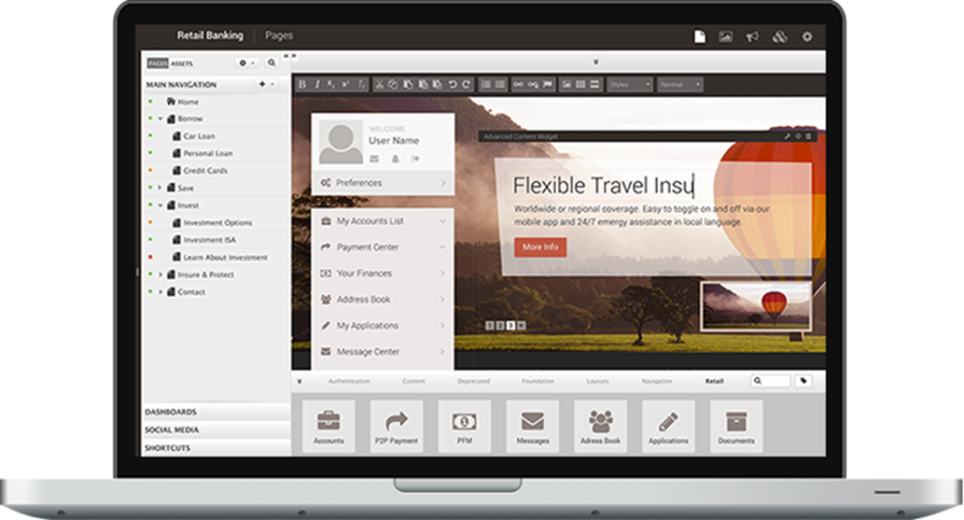
Visual Editing & Publishing of Content
Vsurf banking experience
In-context-editing of content across Marketing Websites and Mobile Banking Apps
Customizable workflows for verification and publication rules.
Reuse content and assets across all digital touch-points.

Slide 17


Robotic Personal Assistant
Vsurf banking experience
Engaging and Personalized ‘Quote & Buy’ experience
Increase sales conversion and minimize abandonment rates
Target relevant digital marketing & sales campaigns.

Slide 18
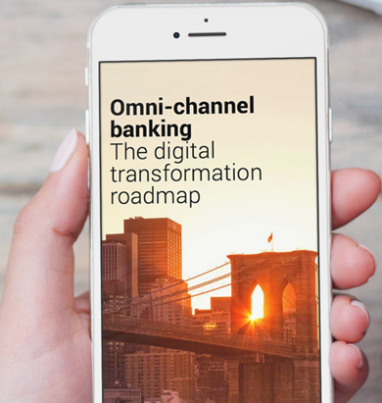
Open an Account with a Smartphone
Vsurf banking experience
Submit photo with a Selfie
Scan & Upload all KYC documents
E-verify Aadhar / PAN / Passport etc
Form-filling assistance from Customer care
E-signature on the application form
Open an account without walking into the bank!
Analytics to track and monitor the campaign’s results (For Bank’s management)

Slide 19
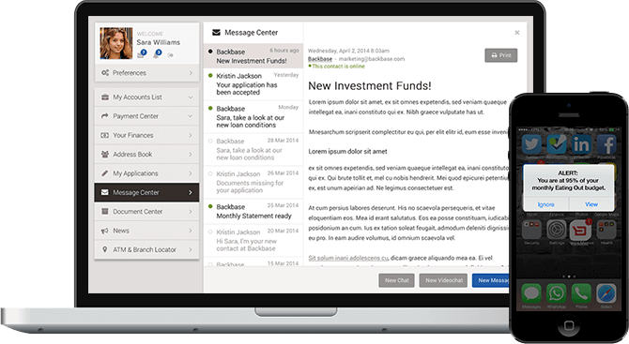
Real-time Alerts, Chat & Messages
Vsurf banking experience
Communicate directly with customers via the integrated message center.
Push important notifications and alerts to customers’ mobile devices.
Real-time Customer-Advisor Communication
Integrated Click-2-Chat and Click-2-Call functions.

Slide 20
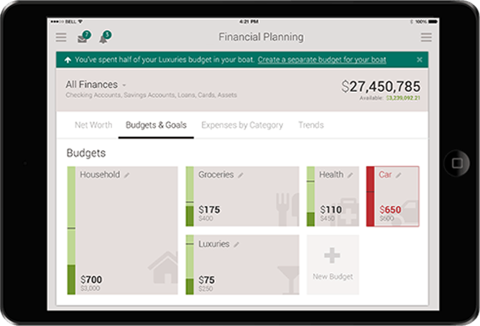
Multi-bank Personal Finance Management
Vsurf banking experience
Wizards and Calculators to offer direct financial advice at the most important moments
Personalized promotions that are relevant to life-events / stages
Aggregate view of funds across banks
Wizards and Calculators to offer direct financial advice at the most important moments
Personalized promotions that are relevant to life-events / stages
Aggregate view of funds across banks
Orchestration for acquiring premium customers of other banks (For Marketers)

Slide 21
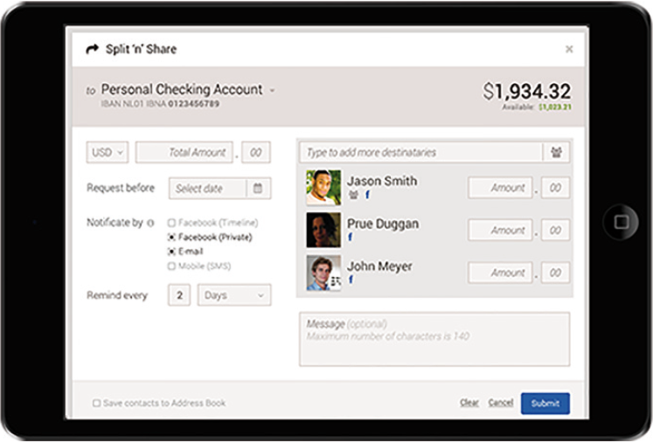
Split payments
Vsurf banking experience
Split ‘n’ share bills and payments among friends
Share or shift payments across banks, across payment modes
Address book integration with Social media / email.
Easy re-imbursements for the employees!

Slide 22
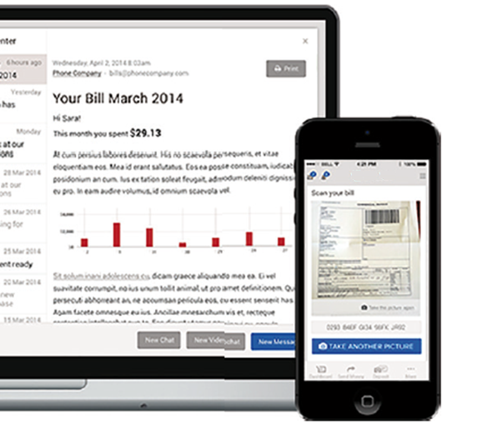
Easy Bill Payments & Fund transfers
Vsurf banking experience
Check and validate bills emailed directly to the secure message center for fast, secure payments.
Optical character recognition (OCR) & mobile scanning capabilities for paper invoices from pre-selected vendors for speedy payments.

Slide 23
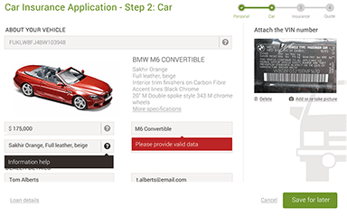
Adaptive Forms With Device Switchover Capability
Vsurf banking experience
Pre-fill forms from scanned paper documents / data fetched from other sources.
Integrate with best-of-breed digital signature technology.
Rules for routing submitted forms to the right systems and people within your organization.
Follow and adapt as the customer switches devices!
Start on a Smart Phone through a flash offer
Research, Compare, Draft over Tablet
Complete draft and submit over Desktop

Slide 24
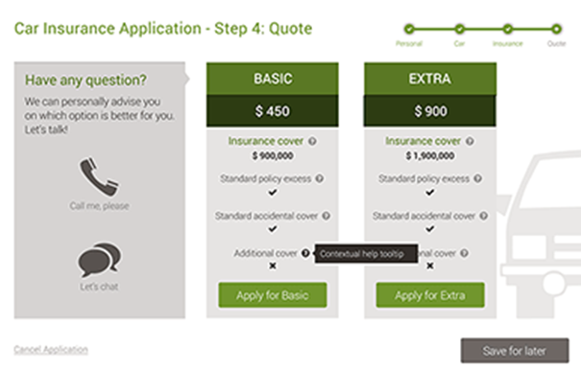
Contextual Support within Forms
Vsurf banking experience
Contextual assistance via smart help and guided navigation.
Ability to contact customer service via chat or phone from within the form.
Automated Form “hand-over” to customer support employee for personal assistance.
Co-browsing to help fill ‘tough’ forms
Cross-device orchestration functionality ensures that customers never have to start a form from scratch when switching devices.

Slide 25
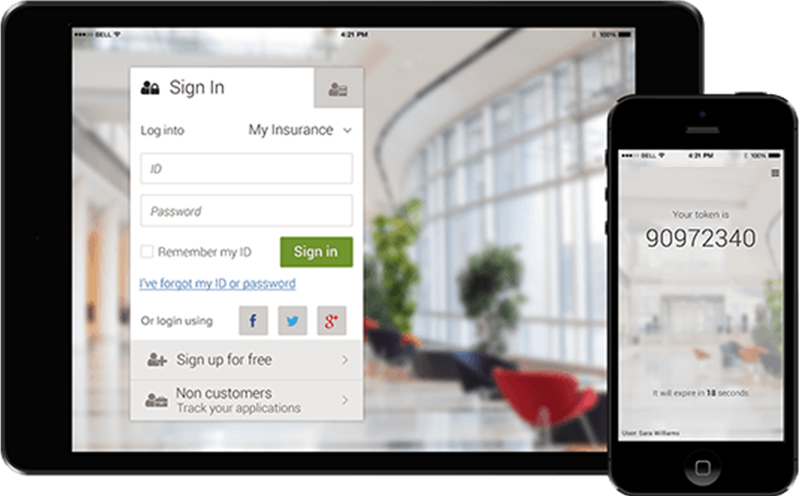
Security for every access
Vsurf banking experience
Three layered security model: anonymous login, soft-login, hard login.
Integrated multi-factor authentication (MFA) via token device, mobile app, or SMS.
Ability to require step-up authentication for high risk transactions.
Login with Facebook / Twitter.

Slide 26
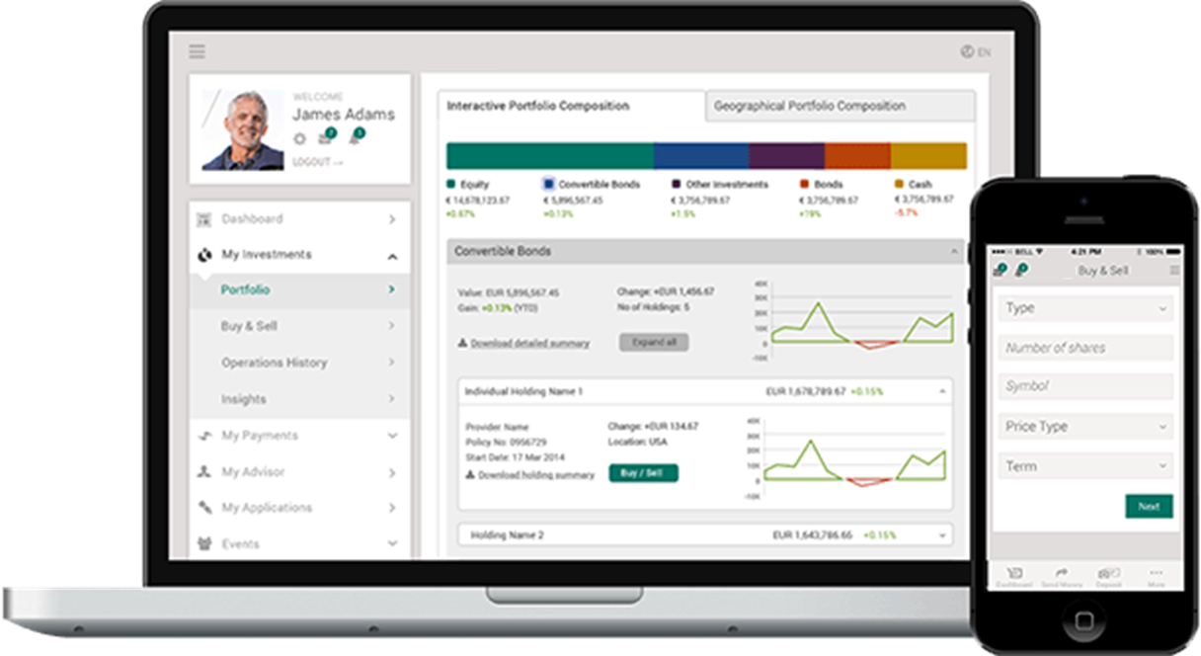
Portfolio Manager
Vsurf banking experience
Gives the client full control over the complete portfolio.
Offers the same functionality as Portfolio Viewer but with the customer in control of investment choices.
Flexibility to support assets ranging from stocks, EFTs, mutual funds, and bonds & fixed income, to options, futures, forex, and international investing.

Slide 27
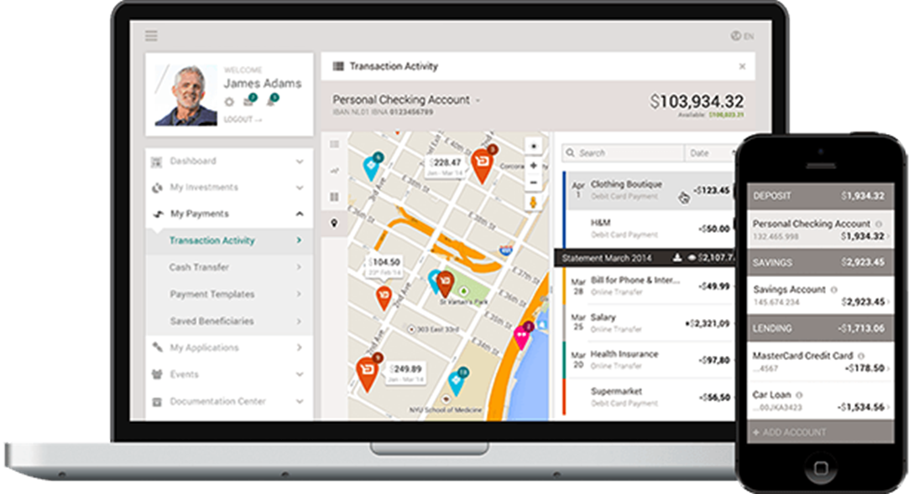
Transaction Tracking on Google Maps
Vsurf banking experience
Easily monitor balances of all accounts, including checking, savings, debit and credit cards, personal, and mortgage loans among others.
Dive into transaction details with strong filtering options, integrated maps, plus tagging and categorization tools.
Track completed and pending transactions, including ATM visits, debit card purchases and direct deposits.
Custom grouping of accounts and shared accounts between account holders.
Ability to add external accounts from other banks.

Slide 28
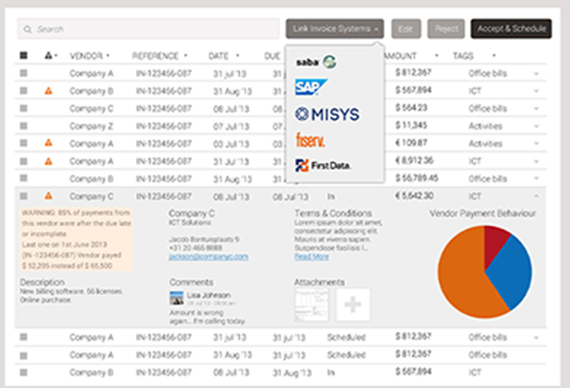
Integration with Accounting Systems
Vsurf banking experience
Import account payable and accounts receivables (invoices) to gain direct insight in your current and future cash position.
Use payment behavior information to predict future cash flows and receive alerts when there is an unpredicted account or currency short fall.
Use invoice information to schedule and approve payments and have all invoice and vendor information in one screen.

Slide 29
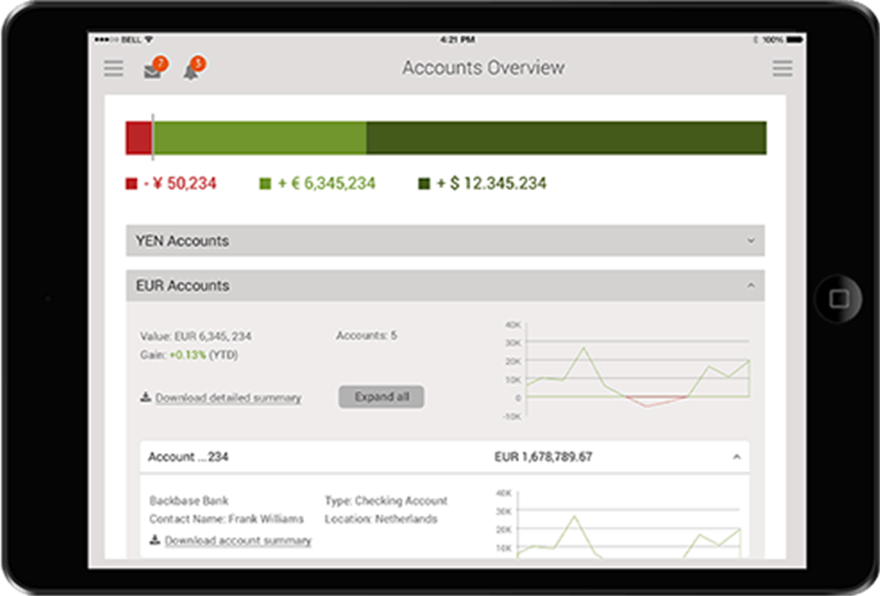
Multi-Account & Multi-Currency Support
Vsurf banking experience
See overviews of multiple accounts, with multiple currencies, aggregated totals, single account totals, and individual transaction details.
Aggregate account balances and other details from all of your banks into a single dashboard.

Slide 30
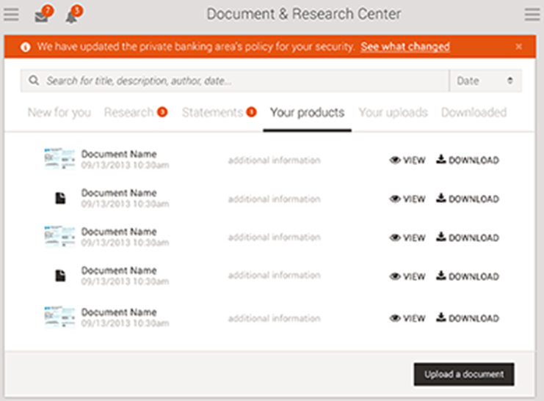
Document Center
Vsurf banking experience
Provides online access to agreements, relevant documents and online images of checks and payments.
Add the latest news and market research tailored towards industries and geographies.
Option to include independent analyst research and market commendatory from internal and external analysts.

Slide 31
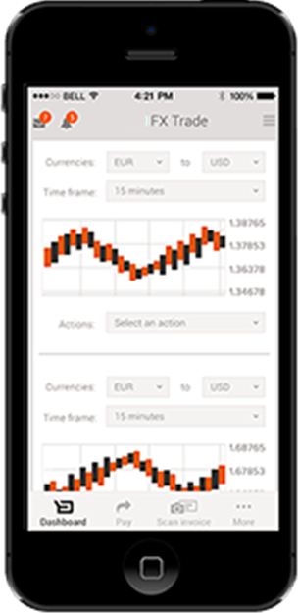
FX Trade
Vsurf banking experience
View current market rates and spread costs accordingly.
Support and execute real-time spot, forward, window, and swap contracts.

Slide 32
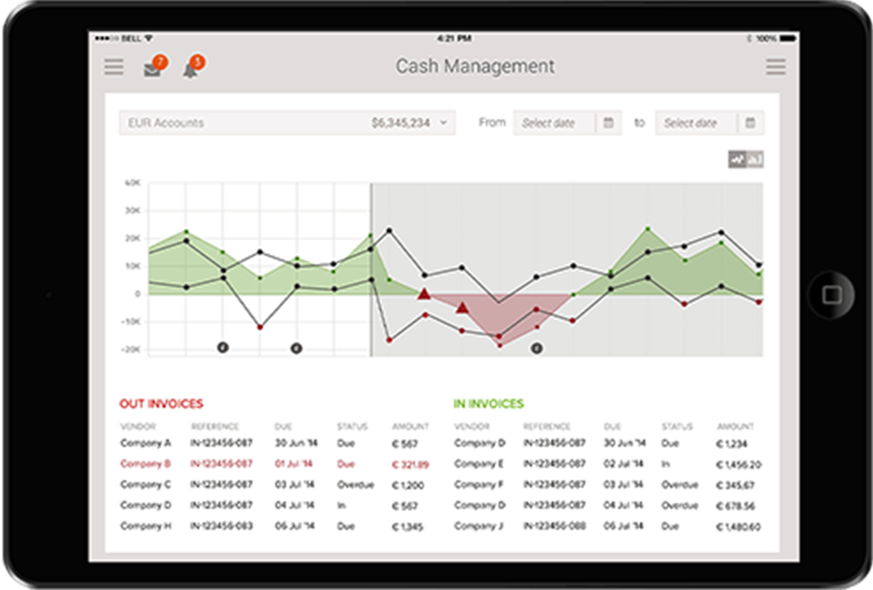
Cash Management
Vsurf banking experience
Integrate with existing cash management systems, to prevent account or currency short falls.
Calculate which option is best for each situation: money transfer, short loan, or FX trade.
Integrated alerting and messaging to warn of unexpected account behavior.

Slide 33
Appendix: virtusa Digital Capabilities

Slide 34
The digital Experience economy
The traditional digital capabilities are no longer enough
4,200
Digital experts for consulting, design, development & QA
200+
Projects executed globally
15+ Years
Delivering digital programs to enterprises
MOBILITY & CONNECTIVITY
UX
Dx
CLOUD
DATA
Experience design
Design exploration
Technology selection
Omni-channel
Digital marketing
Ecommerce
Assessment
Development
Migration
Apps
QA
Deployment
Data strategy
Master data management
Business intelligence
THEN
Smart UX
Design repositories
Visual asset tagging
Industrialized digital
Experience as code
Accelerated experiences
Integrated digital platforms
Cloud everywhere
Instant infrastructure
Micro-service transformation
Automated Dev-ops
Voice as the interface
NLP
Data lakes
“Machine to machine” learning
Pervasive analytics
Ai driven, self adapting experiences
Golden Record
NOW
Notes:
Digital is our fastest growing service line – 30%+ per year
Agency strategy and technology
Very strong UX, design thinking, lean startup culture
Over 100 enterprise mobile apps
Largest cloud migration
Some of the largest data companies

Slide 35
Complete Digital Transformation
Our digital program
Customer Insights
Data driven Marketing
ROI & KPI measurements
Customer 360
Digital business models
Digital products
As a Service offerings
Connected products
Personalization
Omni-Channel Experience
Next-Best Actions
Personalized Offers
Innovation velocity
Product/service differentiation
Transitioning physical to digital
Idea generation and execution
Revenue Generation
Customer Experience
Business
Model
Targeted sales
Predictive marketing
Boost Conversions
Business Agility
Adaptability to change
Globalization
Competitive Advantage
Operations
Process Automation
Workplace Efficiency
System Agility & Scalability
Robotic Process Automation
Operational transparency
Risk and compliance
Productivity and collaboration
Mobile worker field enablement
Employee engagement
Platform efficiencies
Cloud & micro-services adoption
Data-driven decision-making

Slide 36
























AEM Credentials
Adobe Technologies
Business Partner with Adobe with over 260 Adobe Experience Manager (AEM) consultants and over 40 major AEM projects delivered for 20 clients
Representative clients
Major AEM implementation projects
2015
Innovation Partner
of the Year
What differentiates us?
“Service firms’ greatest opportunity is to add additional functionality with vertical-specific modules and/or frameworks. This is especially true in highly regulated industries (e.g. healthcare, financial services). However, very few service firms have actually done this: we found a few examples like VirtusaPolaris LaunchPad”
Breath and depth of experience
In depth experience of AEM gained from a large number of end-to-end implementations
Innovation and industry solutions
LaunchPad with variations for different sectors, Innovation Labs and Centres of Excellence
Value driven
Focus on business outcome from the outset underpinned by principle of Quality over Quantity

Slide 37











User Experience & Front-End Engineering Capability
UX Capability
500+ Consultants. 200+ Projects.
Technologies
Proven expertise on Industry leading technologies
What differentiates us?
Multichannel
Angular
Adaptive, Relevant and Consistent experiences across all channels for every user.
Ractive
Innovation
Agile UI, Single Page Applications, Hybrid Mobile applications, Screens.
Client Training
Best practices, Deployment Guides, Trainings, Bootcamps

